Slide 1

Capstone Project
Car accident severity (Week 2)

Slide 2

Introduction
The reduction in severity of accidents can be beneficial to the Public Development Authority of Seattle which works towards improving those road factors and the car drivers themselves who may take precaution to reduce the severity of accidents.
The project aims to predict how severity of accidents can be reduced based on a few factors.

Slide 3

Understanding Data

Slide 4
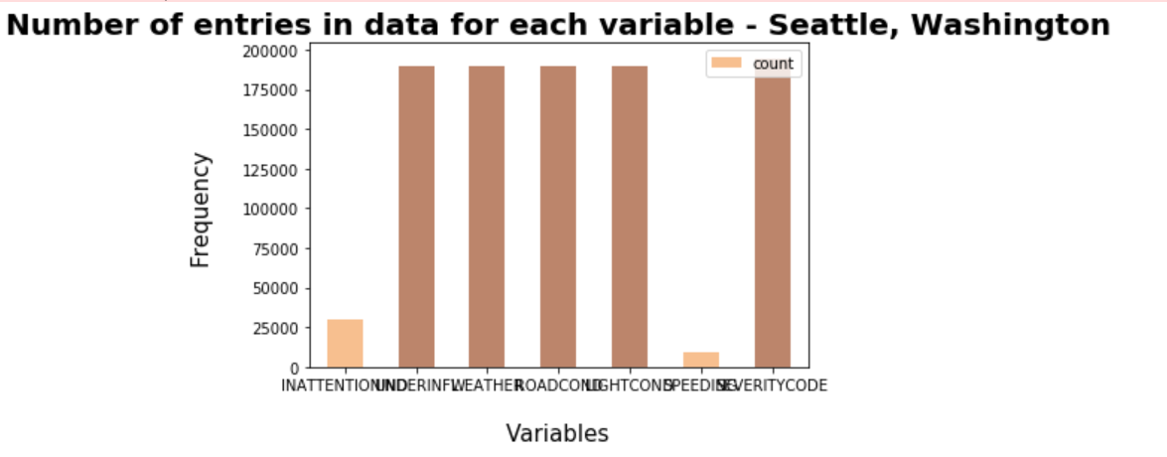
The models aim was to predict the severity of an accident, considering that, the variable of Severity Code was in the form of 1 (Property Damage Only) and 2 (Injury Collision) which were encoded to the form of 0 (Property Damage Only) and 1 (Injury Collision).

Slide 5
Feature Selection
A total of 5 features were selected for this project along with the target variable being Severity Code.
- INATTENTIONIND - UNDERINFL - WEATHER
- ROADCOND - LIGHTCOND - SPEEDING

Slide 6
2. Methodology

Slide 7
Exploratory Analysis
Considering that the feature set and the target variable are categorical variables with the likes of weather, road condition and light condition being an above level 2 categorical variables whose values are limited and usually based on a particular nite group whose correlation might depict a different image then what it actually is. Generally, considering the effect of these variables in car accidents are important hence these variables were selected.

Slide 8
Machine Learning Model Selection
Logistic Regression
Decision Tree Analysis
k-Nearest Neighbor
The machine learning models used are Logistic Regression, Decision Tree Analysis and k-Nearest Neighbor.

Slide 9
3. Results

Slide 10
Decision Tree Analysis
Decision Tree Classifier from the scikit-learn library was used to run the Decision Tree Classification model on the Car Accident Severity data.
The criterion chosen for the classier was `entropy' and the max depth was `6'. The post SMOTE balanced data was used to predict and t the Decision Tree Classifier.

Slide 11
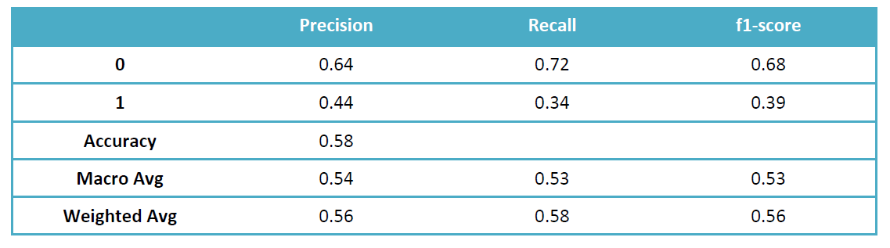
Classification Report

Slide 12
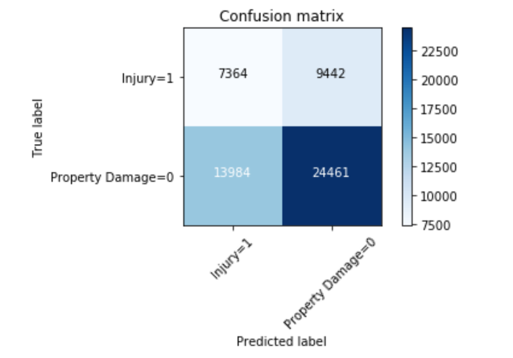
Confusion Matrix

Slide 13
b. Logistic Regression
Logistic Regression from the scikit-learn library was used to run the Logistic Regression Classification model on the Car Accident Severity data. The C used for regularization strength was `0.01' whereas the solver used was `liblinear'.
The post-SMOTE balanced data was used to predict and t the Logistic Regression Classier.

Slide 14
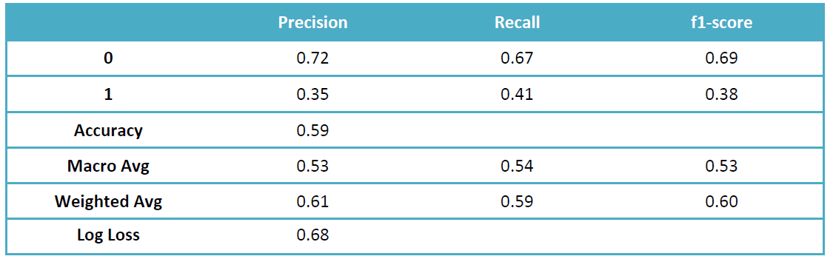
Classification Report

Slide 15
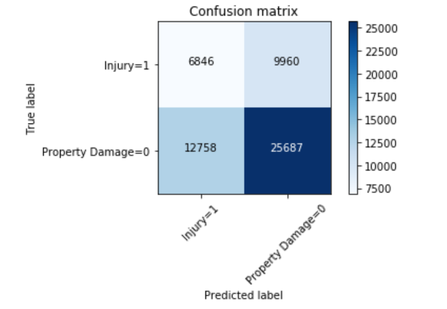
Confusion Matrix

Slide 16
c. k-Nearest Neighbor
k-Nearest Neighbor classifier was used from the scikit-learn library to run the k-Nearest Neighbor machine learning classier on the Car Accident Severity data.
The best K, as shown below, for the model where the highest elbow bend exists is at 4. The post-SMOTE balanced data was used to predict and t the k-Nearest Neighbor classifier.

Slide 17
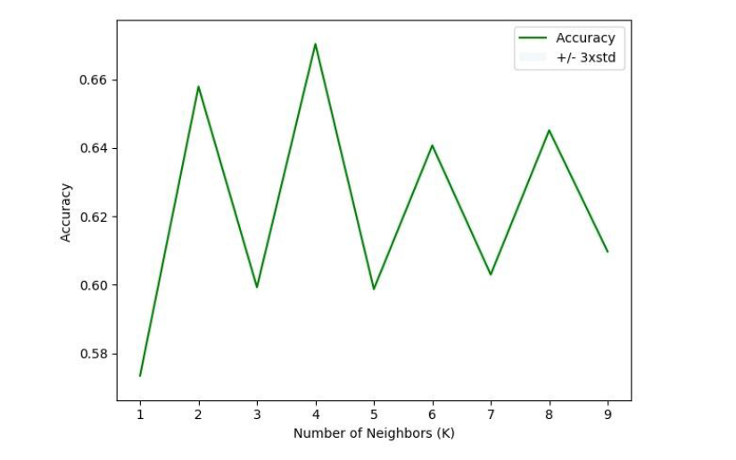
Best kNN value

Slide 18
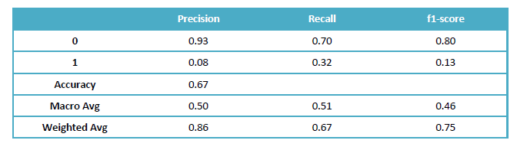
Classification Report

Slide 19
4. Summary

Slide 20
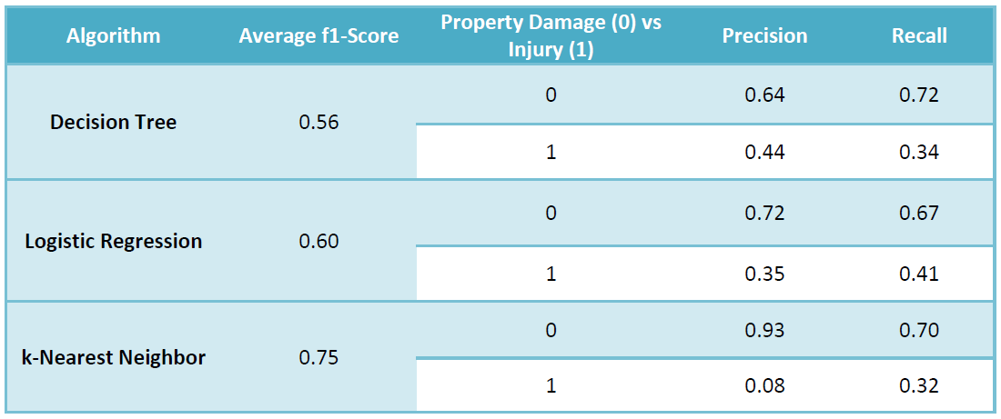

Slide 21
Conclusion

Slide 22
When comparing all the models by their f1-scores, Precision and Recall, we can have a clearer picture in terms of the accuracy of the three models individually as a whole and how well they perform for each output of the target variable. When comparing these scores, we can see that the f1-score is highest for k-Nearest Neighbor at 0.75. However, later when we compare the precision and recall for each of the model, we can see that the k-Nearest Neighbor model performs poorly in the precision of 1 at 0.08. The variance is too high for the model to be selected as a viable option. When looking at the other two models, we can see that the Decision Tree has a more balanced precision for 0 and 1.
Whereas, the Logistic Regression is more balanced when it comes to recall of 0 and 1. Furthermore, the average f1-score of the two models are very close but for the Logistic Regression it is higher by 0.04. It can be concluded that the both the models can be used side by side for the best performance.

